Slide 1
Sales & Service Data Analysis
June 30, 2024
Epsilon Data Science
Navya Bingi, Data Science Intern

Slide 2
Agenda
Data cleaning
Sales EDA:
- Sales performance
- Profitability analysis
- Key insights
Service EDA:
- Service order types
- Customer and model analysis
- Key insights

Slide 3
Data Cleaning
Outliers were eliminated using the IQR method
Duplicate VehicleID, EXT_CUST_ID pairs were removed
→ Each customer should only have 1 copy of each vehicle they bought
Filtered dataset to include only recent sales and service data (2022 and above)

Slide 4
Sales EDA

Slide 5
Sales Performance

Slide 6
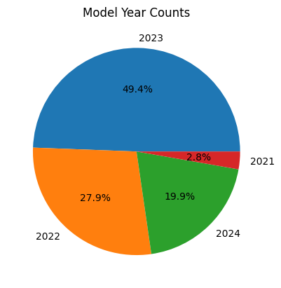
Which model year is popular?
Almost 50% of vehicle sales are 2023 model years
2022 model years were sold 30% of the time, while recent 2024 models were not as popular

Slide 7
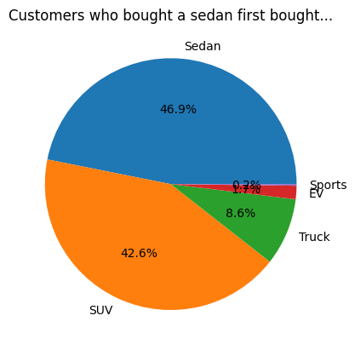
Are those that bought sedans first buying them again?
50% of people who bought a sedan first bought another sedan
About 43% ended up buying an SUV after

Slide 8
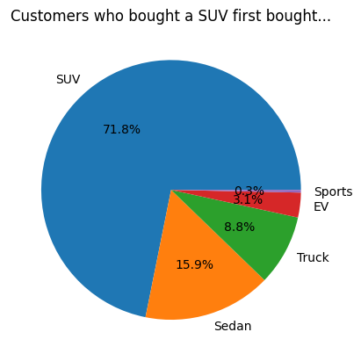
Are those that bought a SUV first buying them again?
A large proportion of first-time SUV customers bought another SUV

Slide 9
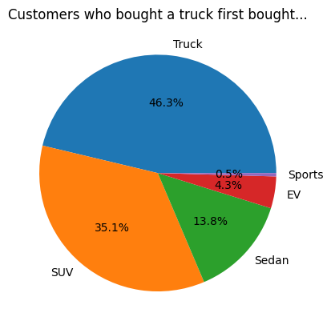
Are those that bought a truck first buying them again?
Almost half of the customers who bought a truck first bought another truck
35% ended up buying an SUV instead

Slide 10
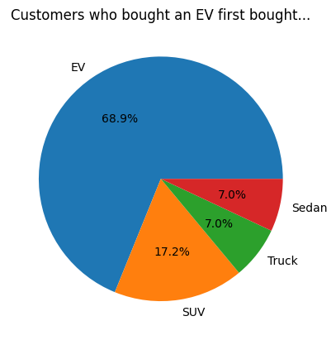
Are those that bought an EV first buying them again?
70% of customers who bought an EV first bought another EV

Slide 11
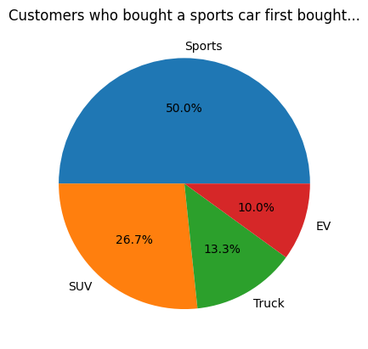
Are those that bought a sports car first buying them again?
Half of the customers who bought a sports car first bought another one
Almost 30% ended up buying an SUV instead

Slide 12
Profitability Analysis

Slide 13
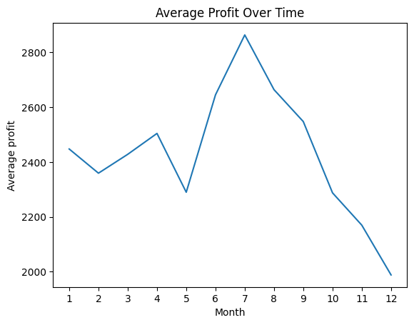
Which month is the most profitable?
For dealerships, the month of July was the most profitable
Profits significantly went down after July

Slide 14
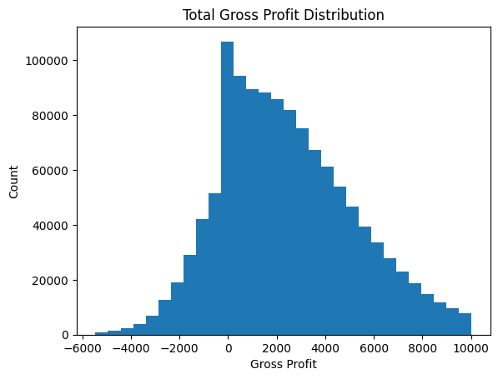
Distribution of Total Gross Profit
Total gross profit follows a normal distribution, centered around $2417.
A profit of $0 seemed to be more common

Slide 15
Key Insights
Almost half of the customers bought 2023 model years.
Most customers who bought a sedan first bought another sedan or an SUV.
But 70% of those who bought an SUV first bought another SUV, same with an EV.
According to the total gross profit distribution, a gross profit of $0 was very common. The highest gross profit was around $10000.

Slide 16
Service EDA

Slide 17
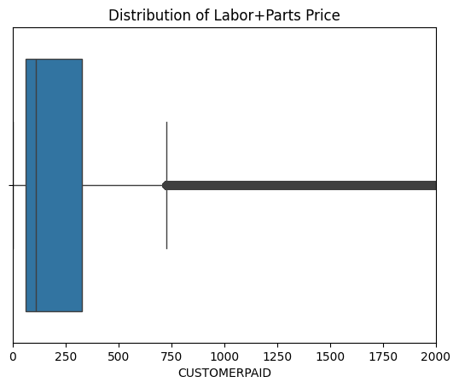
Distribution of Customer Paid Labor+Parts Price
The total customer paid labor+parts price is below $750, with the average being under $250.

Slide 18
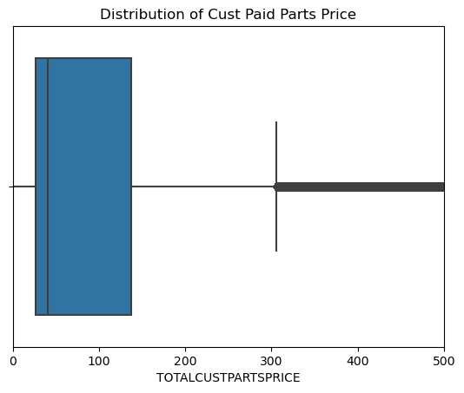
Distribution of Customer Paid Parts Price
The total customer paid parts price is below $300, with the average being under $100.

Slide 19
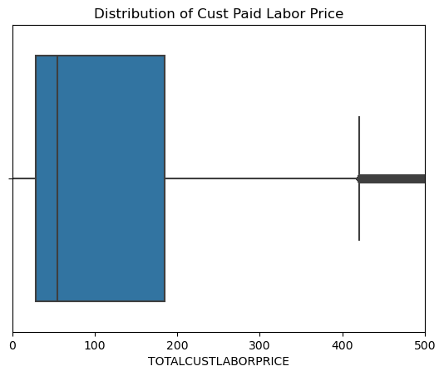
Distribution of Customer Paid Labor Price
The total customer paid labor price is below $400, with the average being under $100.

Slide 20
Service Order Types

Slide 21
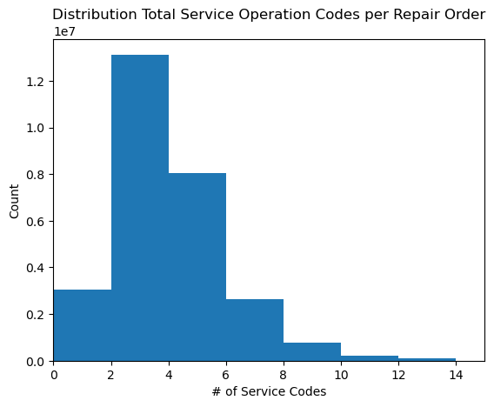
Distribution of # of Unique Codes per Repair Order
Most repair orders have 2-4 unique service codes

Slide 22
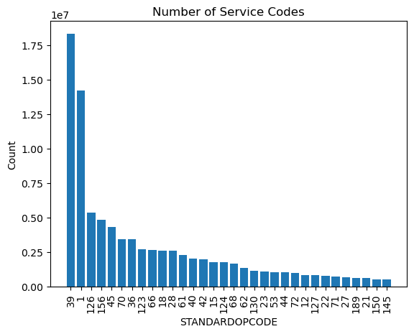
Counts of Unique Service Codes
Service codes 39 (general vehicle inspection) and 1 (lube/oil/filter) are the most popular

Slide 23
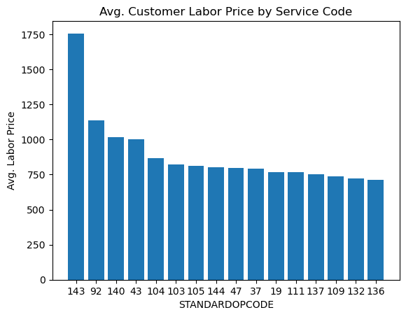
Average Customer Paid Labor Price by Service Code
Service code 143 (transfer case replacement) is the most expensive in terms of average customer paid labor price

Slide 24
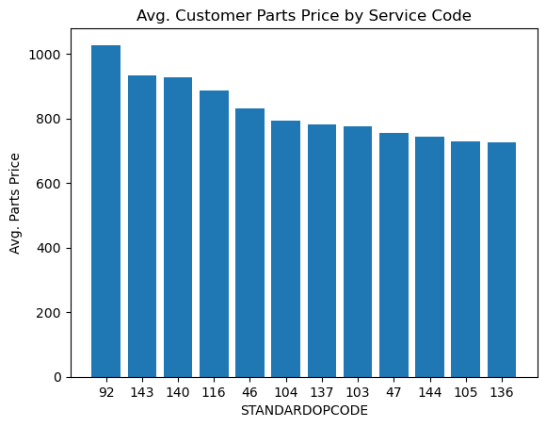
Average Customer Paid Parts Price by Service Code
Service code 92 (air conditioning replacement) 143 (transfer case replacement) is the most expensive in terms of average customer paid labor price

Slide 25
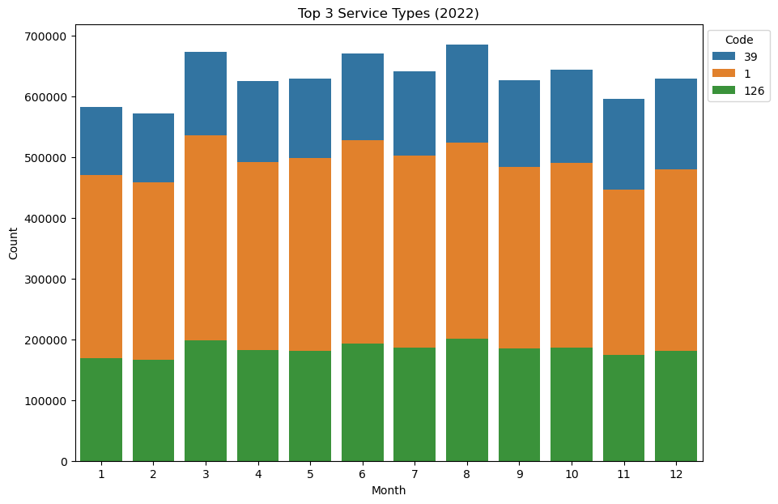
Top 3 Service Codes on Monthly Basis - 2022
Throughout the year, the popularity of certain services remains consistent, with general vehicle inspection, lube/oil/filter, and miscellaneous repairs being the most common
This trend is seen in 2023, too

Slide 26
Customer & Model Analysis

Slide 27
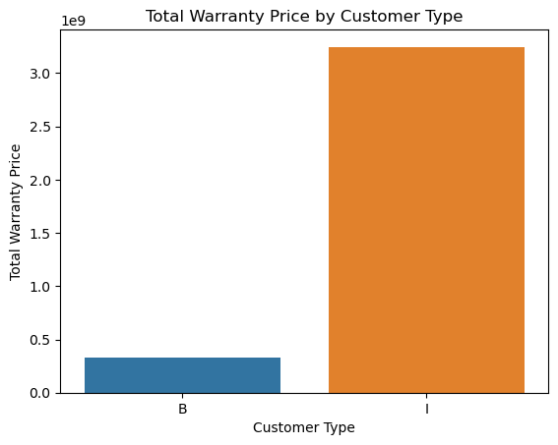
Who takes most advantage of warranty-paid repair services?
Individuals take the most advantage of warranty-paid repair services, with the sum of total warranty price reaching up to $3,000,000,000

Slide 28
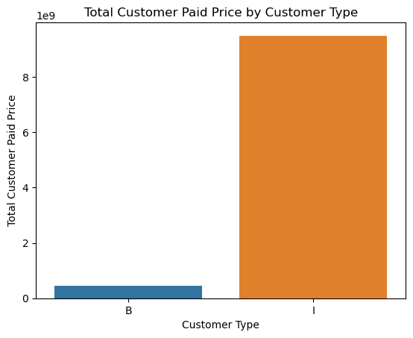
Who takes most advantage of customer-paid repair services?
Individuals take the most advantage of warranty-paid repair services, with the sum of total warranty price reaching up to $9,000,000,000

Slide 29
Key Insights
Customers tend to spend less than $400 on customer-paid labor or parts, with the average price for both being under $100.
Most repair orders opened by customers have 2-4 specific service types, instead of just 1.
Service codes 39 (general vehicle inspection) and 1 (lube/oil/filter) are the most popular
Individuals take the most advantage of warranty-paid and customer-paid repair services
While businesses had a higher average total warranty-paid price of $177, individuals had a higher average total customer-paid price of $341.

